Slide 1
CLASSIFYING PERSONALITY OF TWITTER USERS USING MACHINE LEARNING TECHNIQUES
BHAVANA CHERUKUPALLI 700748205
VARSHA ERROLLA 700742817
SNIDHI REDDY GUDOOR 700745499

Slide 2
ROLES AND RESPONSIBILITIES
Bhavana worked on dataset collection based on the column names required for the project , and sorted different values to fit the specifications.
Snidhi worked on identifying the necessary papers , data selection and front end coding for the project implementation.
Varsha worked on the testing the constraints , documentation and presentation of the project.
Bhavana, Snidhi and Varsha worked together on coding for implementing the dataset by importing , training and testing values.

Slide 3
MOTIVATION
Social media is a platform where people may showcase their identities to the public by sharing intimate information and insights into their lives. We are starting to grasp how some of this knowledge may be used to enhance how users interact with interfaces and one another.
Users' personalities are of interest to us. It has been demonstrated that personality matters for a variety of interactions, including the ability to predict work happiness, the success of romantic and professional relationships, and even a preference for interfaces.
Users had to take a personality test in the past to determine their personalities with any accuracy. The application of personality profiling in many social media domains became impracticable as a result.
In this research, we offer a technique for successfully predicting a user's personality using the information that is made available to the public on their Twitter profile.

Slide 4
OBJECTIVE
The objective here is to identify the most accurate models for predicting the personality traits of Openness, Conscientiousness, Extraversion, Agreeableness, and Neuroticism based on Twitter usage and linguistic analysis.
This project attempts to bridge the gap between social media and personality research by using the information people reveal in their online profiles.

Slide 5
EXISTING SYSTEM
There are various applications for personality prediction. Research has already been done that links personality attributes to success in both personal and professional relationships. Personality insights may be useful for social media technologies that aim to facilitate these interactions.
Additionally, earlier research on personality and interfaces demonstrated that users are more responsive to and more trusting of interfaces and information provided from their personality traits (for example, introverts prefer messages delivered from an introvert's perspective). Online marketing and applications can customize their message and presentation if a user's personality can be inferred from their social media profile.

Slide 6
PROPOSED SYSTEM :
In this project author is asking to predict human personality by taking 5 features such as Openness, Agreeable, Neuroticism, Extroversion, and Conscientious This feature can be identified by a social media dataset called ‘Twitter Profile’.
Openness means intelligent people who express their views boldly or openly. This user expression can be identified by analyzing his Twitter profile and Twitter messages, if a person is intelligent then he will use open (open words also called as swear words) or bold words in his tweets. By looking for such words we can identify this person as Openness personality.
Agreeable means people who use words such as ‘am, will have and these words also refer to ARTICLES or AUXILIARY VERBS’, etc. will come in this category. MRC dictionary contains all words of this category and by applying this dictionary to user’s tweets we can predict a person’s category as agreeable.
Neuroticism means peoples in this category is considered as sentiment or emotion, peoples who use words such as ‘ugly, nasty, sad’ etc. will come under this category.

Slide 7
PROPOSED SYSTEM
Extroversion means people in this category are friendly and people with many friends or followers or following on Twitter will come under this category.
Conscientious means people who express hard-working ideas in their posts will come under this category.
So, by analyzing the above 5 features O (openness), C (Conscientious), E (Extroversion), A (Agreeable), and N (Neuroticism) from Twitter profiles and posts we can predict the personality of a person.
We will find the average of each feature from tweets and then apply the Pearson Correlation formula to get scores for all five features. If the score > 0.1 for any feature, then the person belongs to that category. If a person has a 0.1 value for more than 1 feature, then that person’s personality belongs to that many categories. For example, the same person can be predicted as openness, conscientious, etc.

Slide 8
ALGORITHMS USED
SVM
Random Forest
Naïve Bayes
Logistic Regression

Slide 9
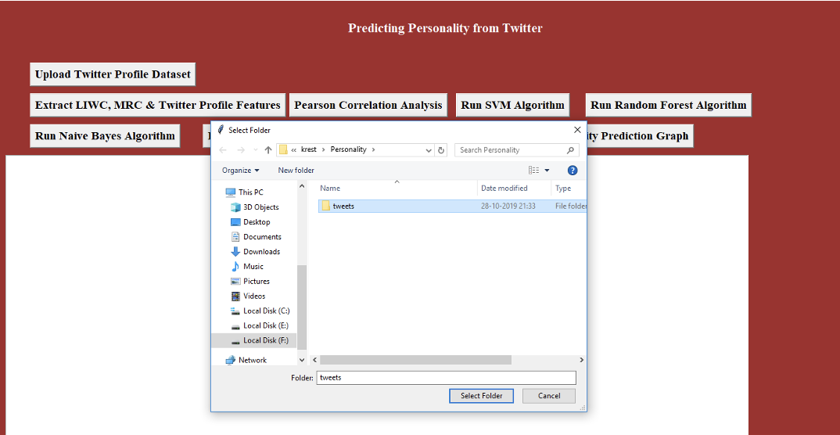
RESULTS

Slide 10
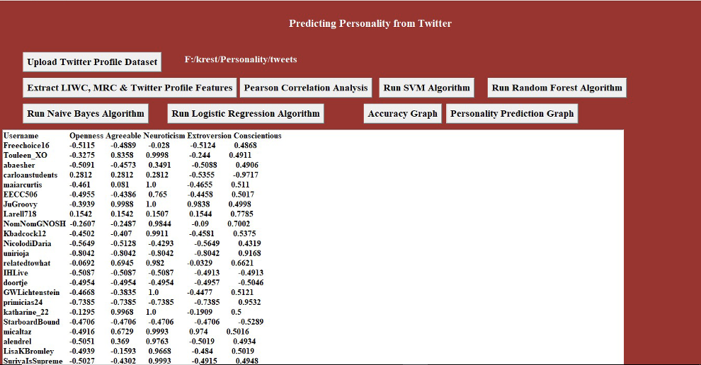
RESULTS : Pearson Correlation Analysis

Slide 11
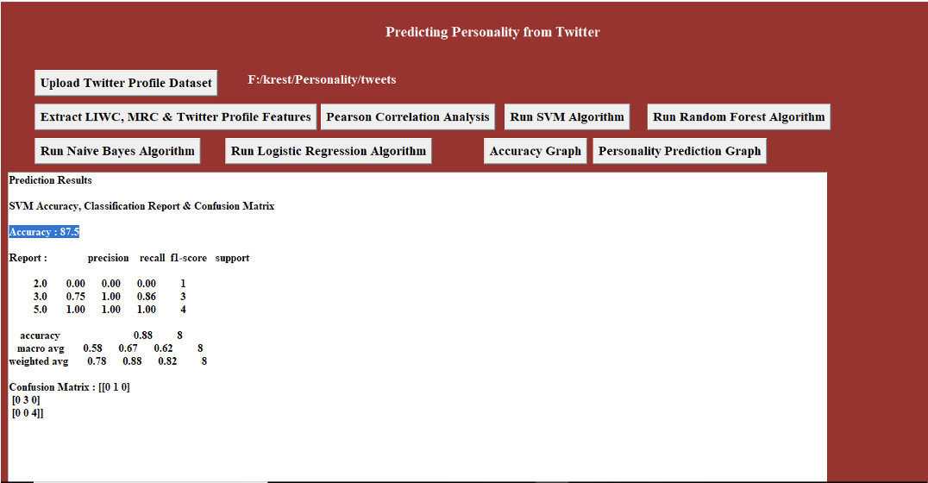
RESULTS : SVM ALGORITHM

Slide 12
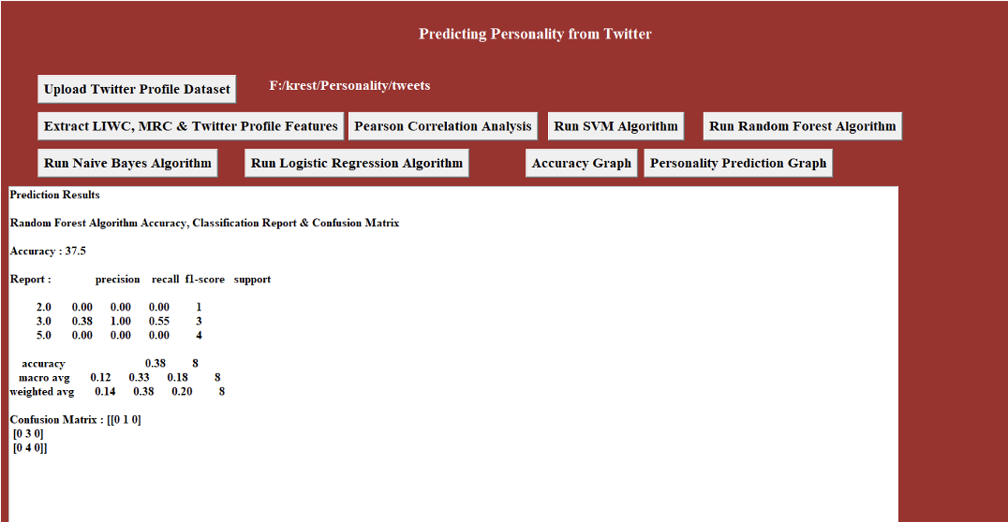
RESULTS : RANDOM FOREST ALGORITHM

Slide 13
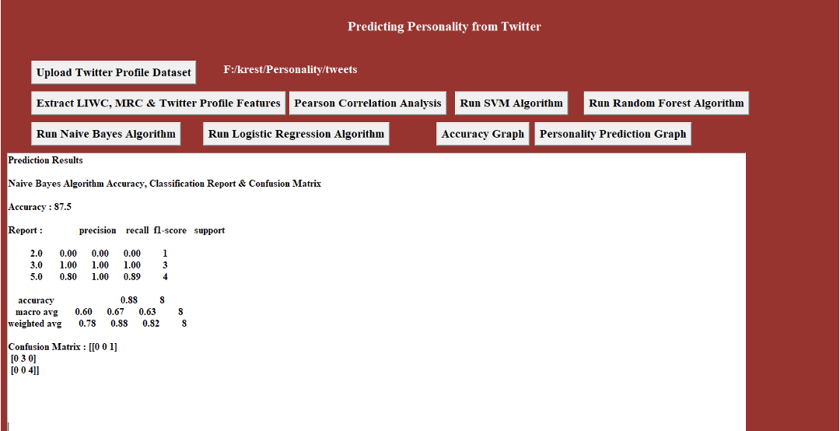
RESULTS: NAÏVE BAYES ALGORITHM

Slide 14
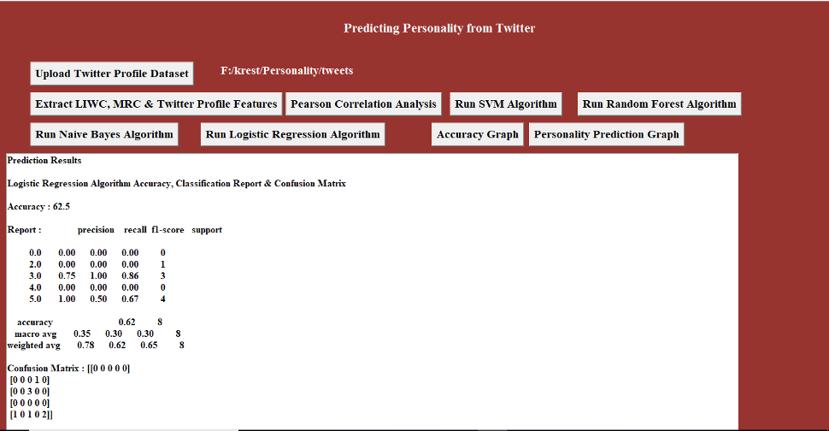
RESULTS: LOGISTIC REGRESSION ALGORITHM

Slide 15
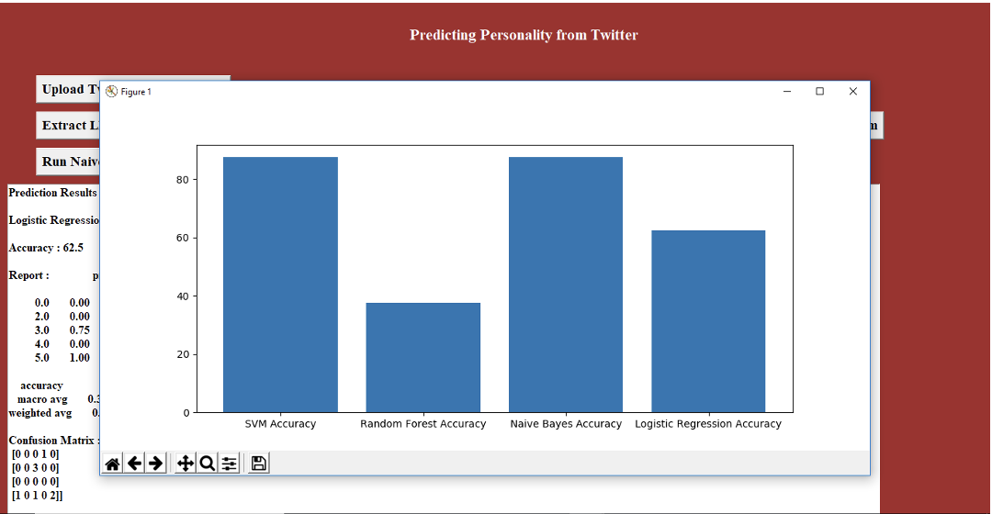
ACCURACY GRAPH

Slide 16
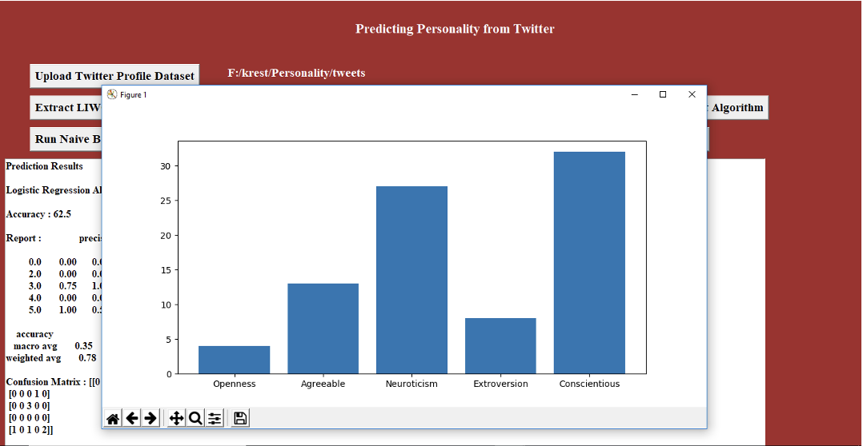
PERSONALITY PREDICTION GRAPH

Slide 17
REFERENCES
[1]. Rahman, S., Chakraborty, P.: Bangla document classification using a deep recurrent neural network with BiLSTM. In: Proceedings of International Conference on Machine Intelligence and Data Science Applications (2020)
[2]. Zulfikar, M.S., Kabir, N., Biswas, A.A., Chakraborty, P., Rahman, M.M.: Predicting students’ performance of the private universities of Bangladesh using machine learning approaches. Int. J. Adv. Comput. Sci. Appl. 11(3), 672–679 (2020)
[3]. Chakraborty, P., Yousuf, M.A., Rahman, S.: Predicting level of visual focus of human’s attention using machine learning approaches. In: Proceedings of International Conference on Trends in Computational and Cognitive Engineering (2021).
[4]. Chaudhary, S., Sing, R., Hasan, S.T., Kaur, I.: A comparative study of different classifiers for Myers-Brigg personality prediction model. IRJET 05, 1410–1413 (2021)
[5]. Plank, B., Hovy, D.: Personality traits on twitter–or–how to get 1,500 personality tests in a week.
[6]. 25 Tweets to Know You: A New Model to Predict Personality with Social MediaPierre-Hadrien Arnoux, Anbang Xu, Neil Boyette, Jalal Mahmud, Rama Akkiraju, Vibha Sinha472(2020). Personality classification based on Twitter text using Naïve Bayes, KNN, and SVM.

Slide 18
REFERENCES
[7].Liu, L., et al. 2020 Analyzing Personality through Social Media Profile Picture Choice.Tenth International AAAI Conference on Web and Social Media.
[8]. Ben Verhoeven and Walter Daelemans. 2021. CLiPS Stylometry Investigation (CSI) corpus: A Dutch corpus for the detection of age, gender, personality, sentiment, and deception in text.
[9]. Kenter, T., and de Rijke, M. 2019.. In Proceedings of the 24th ACM International on Conference on Information and Knowledge Management. 1411-1420: ACM. Personality classification based on Twitter text using Naïve Bayes, KNN and SVM.
[10].Liu, L., et al. 2019. Analyzing Personality through Social Media Profile Picture Choice.Tenth International AAAI Conference on Web and Social Media.
[11]. Ben Verhoeven and Walter Daelemans. 2018. CLiPS Stylometry Investigation (CSI) corpus: A Dutch corpus for the detection of age, gender, personality, sentiment and deception in text

Slide 19
THANK YOU

